Slide 1



Human-Led,
AI-Supported
PracticalTipsforStudents
JohnHill
PrincipalAcademic,Economics
LeadforDigitally-EnhancedLearning
February2026
TheuseofAIduringcourseworkmustbeexpresslypermittedbyyourmoduleleader.Thisdemonstrationisnotasubstituteforthatpermission.

Slide 2
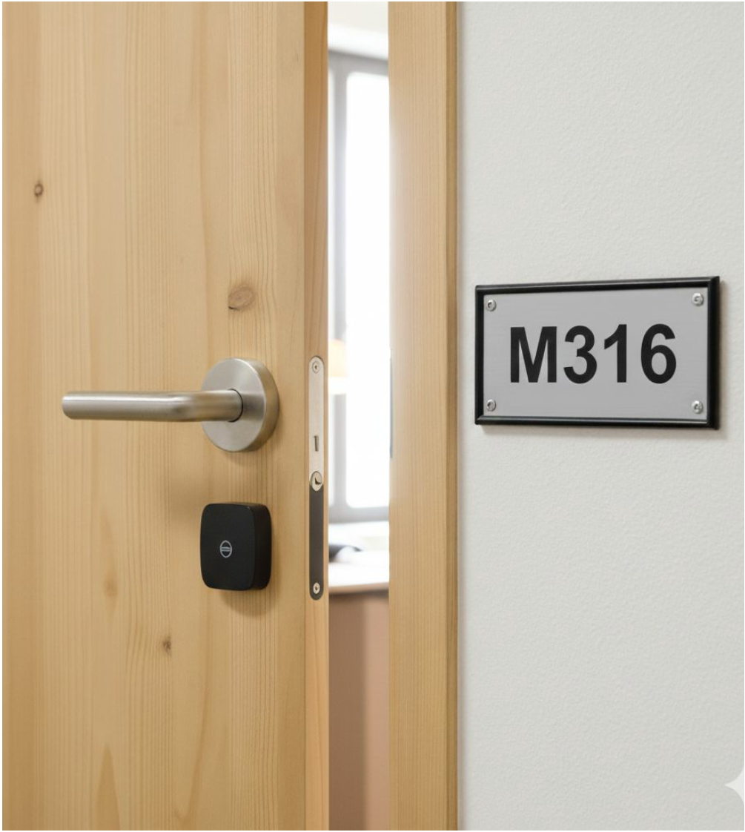


Gettingintouch
Email:j.hill@herts.ac.uk
Office:M316
Dropinanytime/day
EmailaheadtoconfirmthatI'mthere
ThisiswhatGoogleGeminithinksmy
officedoorlookslike

Slide 3
Comingup
1.WhencanLLMshelp?
2.StrengthsandWeaknessesofLLMs
3.Whatisprompting?
4.Buildingastrongprompt
5.Non-GenerativeUsesofLLMs
6.OrganisingthatfolderofPDFs
7. PowerUsers:diagramsfromtext
8. PowerUsers:`code`blocks
9. PowerUsers:tablesastext
10.UHGuidance,andEthicalUseofAI

Slide 4









Assumingonlyfreetieraccess
OtherLLMsareavailable:Meta,DeepSeek,Grok(X),Perplexity(multiplemodels)
YouruniversityOffice365accountprovidesfreetieraccesstoCopilot,withtheadded
protectionofanenterpriseprivacypolicyforUH.
IfyouaresignedintomultipleMicrosoftprofiles(@outlook.compersonalemail),thisspecialprivacypolicyonlyappliestoyour@herts.ac.ukprofile.

Slide 5
WhyandWhen?
AIcanhelpyouthink,organise,check,andunderstand.
Itmustnotreplaceyourjudgement,yourwriting,oryouracademicvoice.
i.e.howyouwoulduselanguage;howyouwouldexplainatheory/concept;
examplesyouwoulddrawon;andhowyouspeakwheninterviewed.
UsingAIisoptional,andnotneededforeverytask.
UseofAIforcourseworkisnotpermittedunlessexpresslyallowedbyyourtutor—
readtheassignmentbrief,andlocatetherelevantAIDeclarationcoverpage
UseAItosupportlearning,nottoproduceassessablecontent.
Guidingprinciple:UseAItothinkwith—nottowriteforyou.

Slide 6
TheGoodandBadofLLMs
Strengths
Structuredprogrammabletasks
Formativeandstructuredfeedback
Socraticdialogueaslearning
Synthesis,especiallycross-disciplinary
Semanticsearchkillsgatekeeping
(missingtechnicalterminologymaybe
inferredfromcontextanddescription)
Widechoiceofmodelseachwithvery
differentstrengths
Useofmarkdownforstructureddata
Weaknesses
❌Willconfidentlylieyou❌Will
hallucinatebeforeadmittingfailure❌Will
evenhallucinatecodefunctions❌Few
modelsreadattachmentsinfull❌Few
modelswilllimitthescopeoftheir
responsestoyoursupplieddocuments❌
Freemodelshaveverylowmodelcontext,
meaningyourearliestinstructionsmaybe
silentlyforgotten❌**Privacyprobably
doesn'texist**🚨

Slide 7
TheGoodandBadofLLMs
Strengths
Structuredprogrammabletasks
Formativeandstructuredfeedback
Socraticdialogueaslearning
Synthesis,especiallycross-disciplinary
Semanticsearchkillsgatekeeping
(missingtechnicalterminologymaybe
inferredfromcontextanddescription)
Widechoiceofmodelseachwithvery
differentstrengths
Useofmarkdownforstructureddata
Weaknesses
Willconfidentlylieyou
Willhallucinatebeforeadmittingfailure
Willevenhallucinatecodefunctions
Fewmodelsreadattachmentsinfull
Fewmodelswilllimitthescopeoftheir
responsestoyoursupplieddocuments
Freemodelshaveverylowmodel
context,meaningyourearliestinstructions
maybesilentlyforgotten
Privacyprobablydoesn'texist

Slide 8
Prompting:AskingAItodosomething
PromptingistheactofinstructinganLLMtoperformatask.
Apromptmaybeaquestionorsetofinstructions,andmayincludeattachments.
Thequalityofapromptcansignificantlyaffecttheresponsereceived.
LLMsareincrediblypowerfulwhenpromptedwell,butnearlyuselesswhenprompted
poorly.
Thebestpromptsareclear,specific,andstructured.
Theworstpromptsarevague,ambiguous,andunstructured.

Slide 9

What'swrongwiththeseprompts?

Slide 10
ExamplePrompt What'sWrong?
“Summarise
this.”
Toovague—noindicationofwhattosummarise,forwhataudience,
orinwhatformat(bulletlist,length,keypoints).Thisoftenyields
breezy,genericbulletpoints.
Lackscontext,cleargoal,andstructure—projectcouldmean
anything;nodeliverables,deadlines,orconstraintsarespecified.
Modelswillguessatmeaning.
“Helpmedo
myproject.”

Slide 11
ExamplePrompt What'sWrong?
“Summarise
this.”
Toovague—noindicationofwhattosummarise,forwhataudience,
orinwhatformat(bulletlist,length,keypoints).Thisoftenyields
breezy,genericbulletpoints.
Lackscontext,cleargoal,andstructure—projectcouldmean
anything;nodeliverables,deadlines,orconstraintsarespecified.
Modelswillguessatmeaning.
“Helpmedo
myproject.”

Slide 12
ExamplePrompt What'sWrong?
“Makeascheduleformy
week.”
Nocontextaboutwhatshouldbescheduled,priorities,
times,constraints,orobjectives.Withoutcontext,the
modelwillinventdetailsorproduceagenerictemplate.
“I'mreallystrugglingand
Idon'tknowwhattodo.I'm
sostressedabout
everything.”
Speaktoarealperson,notAI.ReachouttoStudent
Well-Being(available24/7viaask.herts.ac.uk),your
programmeteam(workhours),orHAS-Businessfor
academicskillssupportforcoursework.

Slide 13
ExamplePrompt What'sWrong?
“Makeascheduleformy
week.”
Nocontextaboutwhatshouldbescheduled,priorities,
times,constraints,orobjectives.Withoutcontext,the
modelwillinventdetailsorproduceagenerictemplate.
“I'mreallystrugglingand
Idon'tknowwhattodo.I'm
sostressedabout
everything.”
Speaktoarealperson,notAI.ReachouttoStudent
Well-Being(available24/7viaask.herts.ac.uk),your
programmeteam(workhours),orHAS-Businessfor
academicskillssupportforcoursework.

Slide 14



Promptingthatactuallyworks

Slide 15

CRAFT(e)
Context
Role
Action
Format
Targetaudience
(examples,ortemplates)

Slide 16


ExamplePrompt
Context,Role,Actions
Context:
In the context of studying producer theory in intermediate microeconomics.
Role:
You are a personal tutor helping me to prepare for a test.
Actions:
1) Read and index the attached study materials. Recognise diagrams and equations.
2) Verify that your index is complete and faithful, and
ask me any questions needed to clarify the scope of this task.
3) Engage me in a Socratic dialogue about producer theory (30 minutes).
4) Create a personalised study plan (2 hours) based on my responses.
5) Produce 10 multiple choice questions drawn from the attached
study resources only, including relevant diagrams and equations.

Slide 17

ExamplePrompt
Format,Targetaudience
Format:
- Respond interactively in this chat
- Use tables for my study plan
- Use multiple choice questions to test me interactively, and
provide a download of questions/answers afterwards.
- For each MCQ provide feedback on both the correct and incorrect answers,
including page references/links to my uploaded study materials.
Target:
- A second year undergraduate student studying intermediate
economics on a bachelor of economics programme at a British university.

Slide 18
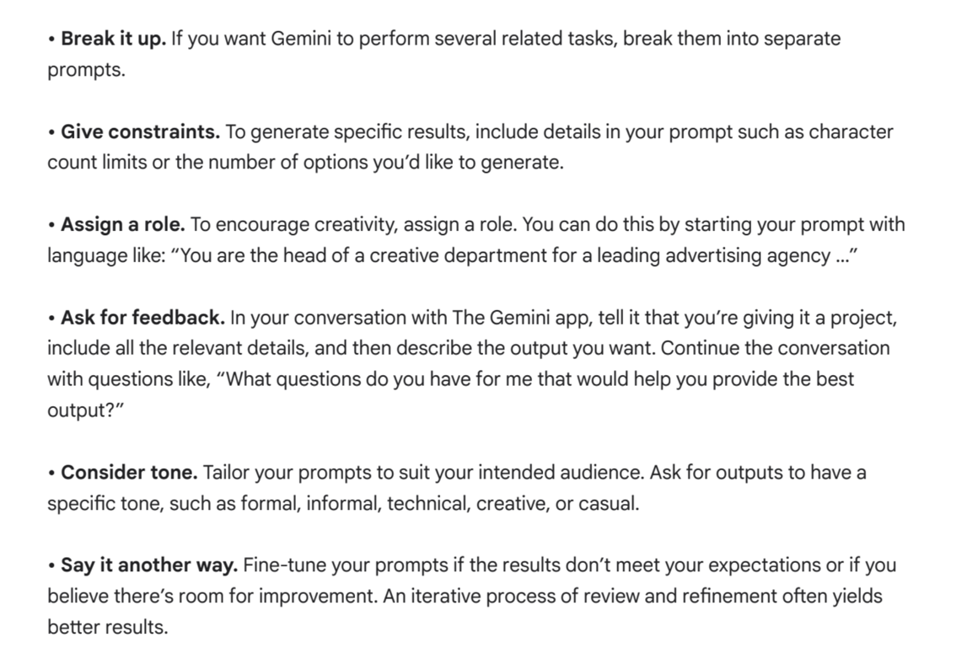
ConfirmedbyGoogle,intheirnewpromptingguide
Source:https://drive.google.com/file/d/1vNeBbxptU91i2gMCCVGAfWKuQgoieXtp/view

Slide 19

OK,
ifgeneratedtext
isbanned,what
elsecanIdo
withLLMs

Slide 20
FormativeConversations
(...promptingittopromptyou...)
Asastudyadvisor...
Turnreadingsintotasklists,studyplans,revisionschedules.
Turnlecturenotesintopracticequestions,flashcards,checklists.
AskforSocraticquestions,notsummaries.
"EngagemeinaSocraticconversationabout[topicX]todevelopmy
understanding..."

Slide 21
FormativeConversations
(...promptingittopromptyou...)
Asawritingcoach...
Pasteyourownwriting,andaskAIto:
IdentifyYOURclaims,evidence/premises,conclusions,gapsinyourlogicor
reasoning,yourrelianceonexplicitandimplicitassumptions;
QuestionthestrengthofYOURreasoning;promptyoutowardsfurtherresearch;
promptyoutoprovideadditionalcounterarguments.
HelpyourfutureselftoavoidacademicmisconductbyinstructingAItonotrewrite
yourprose;itshouldsupportyouthroughquestioning,andofferingformativeadvice.

Slide 22

Whattodowith
thatfolderofPDFs

Slide 23
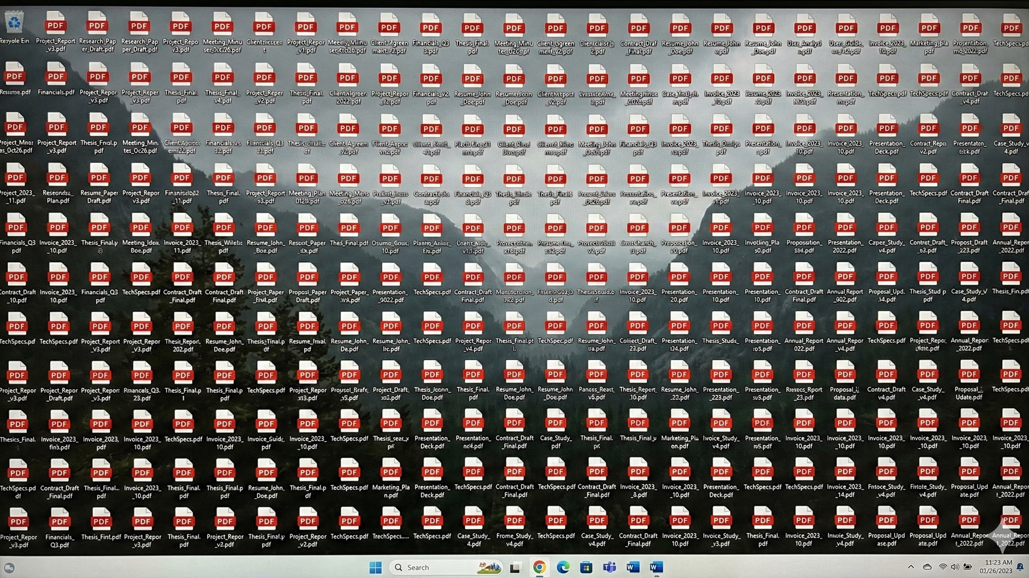

Slide 24



Slide 25
DidAIactuallyread
yourdocument?
ProbablyNot
GeneralistLLMsmayskimlongPDFs
ormisscontentdeepwithinthem.
Whereasspecialist"RAG"(Retrieval
AugmentedGeneration)models
confinetheirresponsestojustthe
informationandattachmentssupplied
byyou

Slide 26
Overviewofdocumenthandling
Feature ^{NotebookLM}
(free)
Copilot
(basic)
UploadPDFs ✓ ✓ ✓(limited) ✓ ✓
...Multiple ✓ ✓ ✓(limited) ✓ ✓
Persistence ✓ ✗forgets ✗forgets ✗forgets ✗forgets
Confined
Response ✓
Claude
(free)
ChatGPT
(free)
Gemini
(free)
Needs
prompting
Pagerefs ✓ Partial Unreliable Partial Partial
Needs
prompting
Needs
prompting
Needs
prompting
Freetierlimitschangefrequently—verifybeforerelyingonthem.

Slide 27
GoogleNotebookLM
ARAGtoolfromGoogleallowingyoutochatwithonlytheinformationandattachments
suppliedbyyou.
Responsesgroundedonlyinyour
sources—RAGbydesign,notby
prompting
Inlinecitationsbacktospecific
passages
Persistentnotebooks—uploadonce,
returnlater
Upto50sourcespernotebook
Afolderofsourcesyoucanchatwith
Idealfordissertations,literaturereviews,
largeprojectswithlotsofdocuments
Eachnotebookisareusablecollection
—onepermodule,oneperassignment
"Free"withanypersonalGoogle
account,whenyouaccepttheirtermsand
privacypolicy.

Slide 28
Practicalworkflow:settingupNotebookLM
Gotonotebooklm.google.comandcreateanewnotebook
Giveitameaningfulname—e.g."5BUSxxxxProjectLiterature"
UploadyourstudymaterialsorGoogleDocsassources
Thetoolindexesthemautomatically—checkthesourcepanel
Startaskingquestions—eachresponsecitesthesourcesyousupplied
Comebackanytime—yournotebookandsourcespersist
Thinkofeachnotebookasamodulefolderyoucanhaveaconversationwith.

Slide 29
Keytakeaways:workingwithdocuments
1.Usetherighttool—NotebookLMforpersistent,source-scopedresearch;Claudeor
ChatGPTforcodecreation,execution,interactivecanvases;Geminiforimagesand
HTML/JScanvases.
2.Verifybeforeyoutrust—maketheAIproveitreadthewholedocument
3.Constrainexplicitly—ingeneralchatbots,telltheAItouseonlyyoursources
4.Testtheboundaries—askquestionsoutsidethedocumentstocheckcompliance
5.Requeststructuredoutput—tablesandcomparisons,notessays
6.Youarethewriter—AIcanorganiseinformation,butcriticaljudgementandwritingis
yourresponsibility.UseAIasyourthinkingpartner,notyourghostwriter.

Slide 30
PowerUsers

Slide 31
Diagramsfromtext
LLMscanuseplaintextdrawinglanguageslikemermaidtoproducemindmaps,timelines,
ganttcharts,andmore.
Ifyourdiscussioninvolvesobviouslevelsorcategories,ornestedinformation,asktheLLM
toproduceamindmapusingmermaid.Thiswillproducethecodeforadiagramthatmay
berenderedusingObsidianorthiswebsite:
https://mermaid.live
Thisisaninsanelypowerfulwaytovisualisecomplextopics.

Slide 32
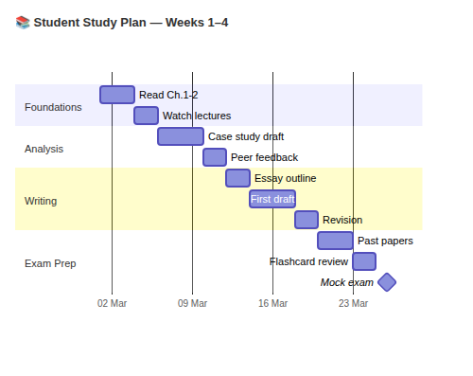
Example:Diagramyourstudyplan
DiagramCode(providedbyLLM)
```mermaid
gantt
dateFormatYYYY-MM-DD
axisFormat%d %b
tickInterval 1week
section Foundations
Read Ch.1–2 :a1, 2025-03-01, 3d
Watch lectures :a2, after a1, 2d
section Analysis
Case study draft :b1, 2025-03-06, 4d
Peer feedback :b2, after b1, 2d
section Writing
Essay outline :c1, 2025-03-12, 2d
First draft :c2, after c1, 4d
Revision :c3, after c2, 2d
section Exam Prep
Past papers :d1, 2025-03-20, 3d
Flashcard review :d2, after d1, 2d
Mock exam :milestone, 2025-03-26, 0d
```
Diagram(Rendered)
Renderedusinghttps://mermaid.live

Slide 33
Context:
A 4-week university study plan
with tasks organised into sections,
provided below
Role:
Act as a Mermaid diagram expert
Action:
Generate Mermaid gantt chart code
for my study plan.
Format:
- Bare Mermaid code only.
- Use `dateFormat YYYY-MM-DD`
as the only directive
Target:
- Simple and readable
- Minimal syntax
- Suitable for a beginner
...continued
| Section | Task | Start | Duration|
|--------------|------------------|----------------|-----------|
| Foundations| Read Ch.1-2 | 2025-03-01 | 3d |
| Foundations| Watch lectures | after previous | 2d |
| Analysis | Case study draft | 2025-03-06 | 4d |
| Analysis | Peer feedback | after previous | 2d |
| Writing | Essay outline | 2025-03-12 | 2d |
| Writing | First draft | after previous | 4d |
| Writing | Revision | after previous | 2d |
| Exam Prep | Past papers | 2025-03-20 | 3d |
| Exam Prep | Flashcard review | after previous | 2d |
| Exam Prep | Mock exam | 2025-03-26 | milestone |

Slide 34
CodeChunks
SubmitcodechunkstoanLLMbysurroundingthemina```codefence.
Yourkeyboardcontainsabackticksymbol`whichisnotanapostrophe.
```r
# this is my R code chunk
read.csv(data/mydata.csv)
```

Slide 35
Tablesastext
IfyourLLMcan'tworkwithspreadsheetfiles,askittoworkinmarkdowntablesinstead.
Theseareknownas"pipetables"becausecolumnsofplaintextareseparatedby|.
UsethiswebsitetoconvertbetweenExcel,htmlandmarkdowntables:
https://www.tablesgenerator.com/markdown_tables
| Header1 | Header2 | Header3 |
|---------|---------|---------|
| Row1 | Row1 | Row1 |
| Row2 | Row2 | Row2 |

Slide 36
ImportantAdvice

Slide 37
AllLLMscanhallucinate
Older(oftenfree)modelshallucinate
more;hallucinationisacreativity
feature,notabug
Researchtoolsaimforan
hallucinationtoleranceof0/10
ButgeneralLLMsusuallytolerate
5/10,whichiseitherverycreativeor
verydangerousdependingonyour
needs
2️⃣**Hallucinationsincodeareeasyto
spot(codewillfail),buthallucinationsin
academicresearcharemuchharderfor
youtospot**>Fake(non-existent)
references,fakecitations,andfakequotes
areseriousacademicintegrityoffences
3️⃣**Donotrelyongenerativetextor
generativecitations,ever**>"Safer"AI-
poweredresearchtoolsincludeScopusAI,
Scite.aiandLitMaps.com,butcheckthem
too.

Slide 38
AllLLMscanhallucinate
Older(oftenfree)modelshallucinate
more;hallucinationisacreativity
feature,notabug
Researchtoolsaimforan
hallucinationtoleranceof0/10
ButgeneralLLMsusuallytolerate
5/10,whichiseitherverycreativeor
verydangerousdependingonyour
needs
Hallucinationsincodeareeasyto
spot(codewillfail),buthallucinationsin
academicresearcharemuchharderfor
youtospot
Fake(non-existent)references,fake
citations,andfakequotesareserious
academicintegrityoffences
3️⃣**Donotrelyongenerativetextor
generativecitations,ever**
"Safer"AI-poweredresearchtools
includeScopusAI,Scite.aiand
LitMaps.com,butcheckthemtoo.

Slide 39
UHResourcesontheSafe&EthicalUseofAI
https://go.herts.ac.uk/academic-skills>Units>AIandYourStudies
https://go.herts.ac.uk/libraryskillup>Units>ArtificialIntelligence
https://ask.herts.ac.uk/ai-tools

